Slide 1
T
22PC1CB201
SOFTWARE ENGINEERING
Topic – 1.1
Introduction to Software :
Programming in Large vs Small

Slide 2
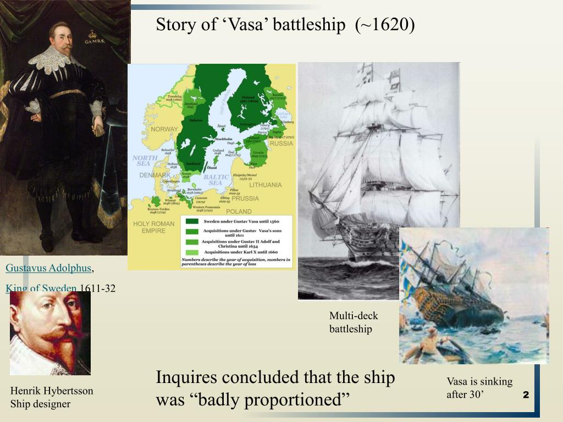
Scenario of “ vasa “

Slide 3
It was the 16th of January in the year of 1625 that King Gustav II Adolph of Sweden sign a contract with the shipbuilders (Hendrik and Arend Hybertsson) to build four ships. Two smaller ships (108-ft keel length) and two bigger ships (135-ft keel length) were to be built over the course of four years. In the months that followed, King Gustav changed his orders several times, leading to total chaos and confusion for the builders.
The Swedish Navy lost ten ships on 10th of September 1625, which lead the king to order that the two smaller ships be built on an accelerated schedule to compensate for those they had lost. One can’t blame him, as those were the days when various parts of the world were colonized, and naval forces meant strength. These were meant to be two small ships (111-ft and 135-ft ships). Please note that the dimensions stated relate to the keel length unless explicitly specified otherwise.
On one front, the construction of the 111-ft ship with a single gun-deck began. Simultaneously, on the other, the king received news that the Danish were building a ship with two gun-decks. How did the king react to this one-upmanship? Yes, if you know anything about the egos of kings and dictators, you will have guessed it right. He immediately ordered Admiral Fleming to build a 135-ft ship with two gun-decks. Until then, no one in Sweden had ever built a ship with two decks. This development from one- to two-deck warships marked a significant change in Naval architecture between 1600–1700.
While the original Vasa was a traditional architecture that was commonly used in shipbuilding, it is believed that it is likely that no specifications, crude designs or plans were made. Hybertsson was an experienced shipbuilder . However, once the circumstances changed, no modified plans were found for the larger, more complex version of the Vasa. Under time pressure, it is believed that Henrik Hybertsson just “scaled-up” the dimensions of the original 108-ft ship to meet the length and breadth of the new 135-ft Vasa. Since this was totally unplanned, the width of the upper parts of the ship was wider than originally planned by one-foot and five-inches.

Slide 4
King Gustav changed his orders several times, leading to total chaos and confusion for the builders.
This development from one- to two-deck warships marked a significant change in Naval architecture between 1600–1700.
it is believed that it is likely that no specifications, crude designs or plans were made
However, once the circumstances changed, no modified plans were found for the larger, more complex version of the Vasa.
Under time pressure, it is believed that Henrik Hybertsson just “scaled-up” the dimensions of the original 108-ft ship to meet the length and breadth of the new 135-ft Vasa.
the primary designer, Henrik Hybertsson, fell ill and died in 1627, almost one year before the Vasa was completed.
The plans were undocumented, there were no detailed specifications, and five different teams were working on the hull without any intercommunication
Was the Vasa Ship Tested?

Slide 5
1. Unreasonable time pressure
2. Changing specifications and lack of documentation or project plan
3. Over innovation
4. Lack of scientific methods and reasoning

Slide 6
Emergence of software engineering as a discipline
Engineering :
Art and profession of
acquiring and applying
technical
Scientific
Mathematical
knowledge to
Design
Implementation materials
Structures
Machines
Processes for desired objectives

Slide 7

IEEE Definition of Software Engineering
The application of engineering to software.
Software engineering is the application of a systematic, disciplined, quantifiable approach to the design, development, operation, and maintenance of software, and the study of these approaches.

Slide 8

Software
A information transformer – Producing, managing, acquiring, Modifying, displaying or transmitting information that is simple/ complex which satisfies the users needs & makes the user world better.
A software is either a collection of programs which will transfer the data from one place to another and satisfies the user’s needs .

Slide 9
Software characteristics
Software is developed or engineered, it is not manufactured .
Software does not wear out.
Although industry is moving towards component based assembling most software continues to be custom built.

Slide 10
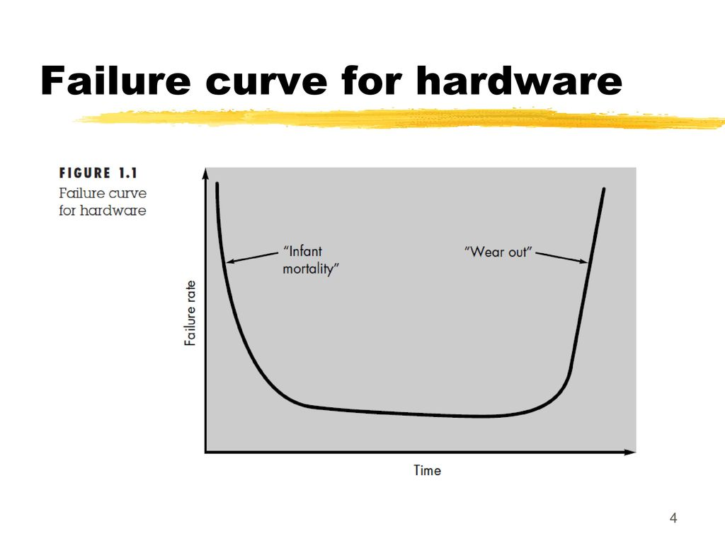
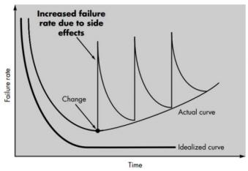
FAILURE CURVE FOR SOFTWARE

Slide 11
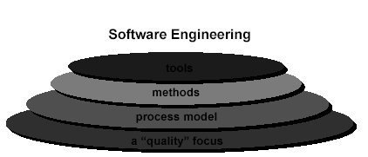
Software Engineering a Layered architecture
Focus on quality : must rest on an organizational commitment to quality.
Process layer : It is the foundation that defines framework with activities for effective
delivery of software. It is glue that holds the technology layers together and enables
timely.
Methods : Provides the technical (which platform) how- to’s for building software.
Tools: Provides automated and semi automated support for process and method e.g MS excel tool is used to applying some formula’s.

Slide 12
THE CHANGING NATURE OF SOFTWARE
System software: such as compilers, editors, file management utilities
Application software: stand-alone programs for specific needs.
Engineering/scientific software: Characterized by “number crunching”algorithms. such as automotive stress analysis, molecular biology, orbital dynamics etc .
Embedded software resides within a product or system. (key pad control of a microwave oven, digital function of dashboard display in a car)

Slide 13
Product-line software focus on a limited marketplace to address mass consumer market. (word processing, graphics, database management)
WebApps (Web applications) network centric software. As web 2.0 emerges, more sophisticated computing environments is supported integrated with remote database and business applications.
AI software uses non-numerical algorithm to solve complex problem. Robotics, expert system, pattern recognition game playing.

Slide 14
Programming in Large Environment
In software development, programming in the large can involve programming by larger groups of people or by smaller groups over longer time periods.
Either of these conditions will result in large, and hence complicated, programs that can be challenging for maintainers to understand.

Slide 15

Programming in Large Environment
Coding managers place emphasis on partitioning work into modules with precisely-specified interactions. This requires careful planning and careful documentation.

Slide 16
Programming in Large Environment
Program changes can become difficult.
If a change operates across module boundaries, the work of many people may need re-doing.
Programming in the large requires abstraction creating skills until a module becomes implemented it remains an abstraction.

Slide 17
Programming in Small Environment
Programming in the small describes the activity of writing a small program.
Small programs are typified by being small in terms of their
  Source code size
  Easy to specify
  Quick to code

Slide 18

Programming in Small Environment
Programming in the small can involve programming by individuals or small groups.
short time periods and may involve less formal practices.

Slide 19

Programming in Small Environment
Programming in the small can also describe an approach to making a prototype software.

Slide 20
Custom built
Software engineering a layered architecture
The changing nature of software
Programming in large vs small
Software failures

Slide 21
Topic -1.2
Software Engineering – Software Failures

Slide 22
Poor planning and/or inadequate process
Inefficient way to document and track progress
Poor leadership at any level
Failure to set expectations and manage them
  Inaccurate cost estimation
  Lack of communication at any level
  Competing resources

Slide 23
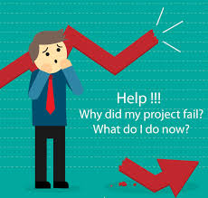
Software Failures Reasons
Poor planning and/or inadequate process
  Define what constitutes project success or failure at the earliest stage.
  Lack of planning leads to inadequate preparation, unexpected problems, and poor execution.

Slide 24
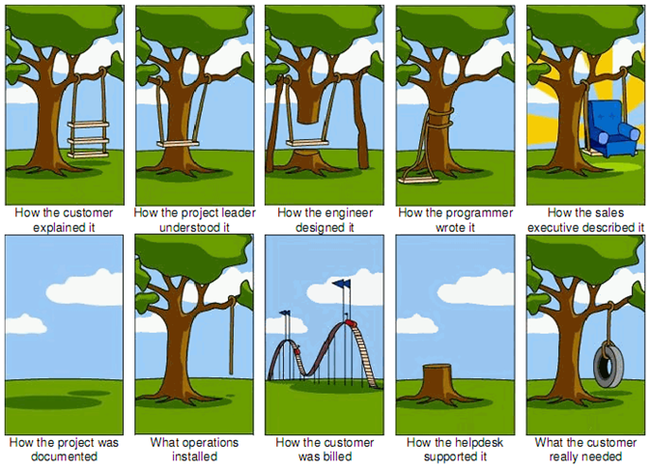

Slide 25
Software Failures Reasons
Inefficient way to document and track progress
  Tracking milestones.
  Documentation and tracking also lets the manager identify which areas require more resources to be completed on time.
Poor leadership at any level
  The management-level executive also has a responsibility of ensuring the project’s success.
  Assign management roles only to individuals who have the capabilities to meet requirements
  should work together with the manager to ensure that the company’s exact requirements are understood.

Slide 26
Software Failures Reasons
Failure to set expectations and manage them
If and when expectations are not met, there should be clearly-defined consequences.
The task should then be prioritized and possibly reassigned to a more competent individual.

Slide 27
Software Failures Reasons
  Inaccurate cost estimation
  When it runs out of resources, the project cannot be completed.

Slide 28
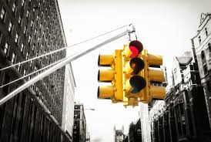
Software Project Failures
Lack of communication at any level
  Communication between the management executive client and the project manager.
  between the team members are always important.
  Competing resources
  there will be competing priorities in terms of manpower and financing. Having good cost estimation at the start will eliminate this problem.

Slide 29
Custom built
Software engineering a layered architecture
The changing nature of software
Programming in large vs small
Software failures
Def of process models
How a project starts
SDLC Phases
Software myths

Slide 30
SOFTWARE MYTHS
Management myths
Customer myths
Practitioner’s myths

Slide 31
Prescriptive process models define a distinct set of activities , actions,tasks,milestones and work products that are required to engineer high quality software.

Slide 32
SDLC Phases
1.INITIAL
2.ANALYSIS
3.DESIGN
4.CODING
5.TESTING
6.DELIVERY AND MAINTENANCE

Slide 33
A + B = 5
        + = 5
1.CASE | 5
 | A 12 B

Slide 34
Case Studies
Suppose you write a computer program to add two integers. Assume that each integer and their sum will fit in the standard memory unit the computer uses for integers. How likely do you think it is that the sum will be correct? (If you run the program a million times on different pairs of integers, how many times do you think it would give the correct answer?)
Draft an assignment on Y2K problem and the solution developed.

Slide 35

REFERENCES
Ian Sommerville, "Software Engineering", Addison-Wesley, 2011.
Fundamentals of Software Engineering, Carlo Ghezzi, Jazayeri Mehdi, Mandrioli Dino
https://www.tutorialspoint.com/software_engineering/index.htm

